Slide 1

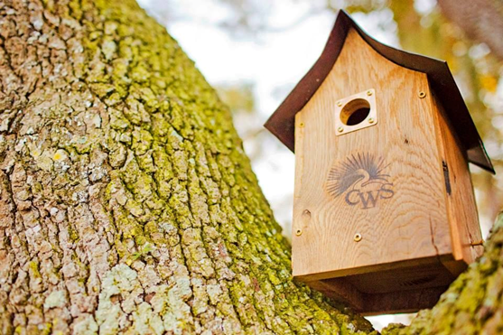
Coastal Habitat Certification
Coastal WildScapes
Preserving and Restoring the Biodiversity of Southeastern Coastal Ecosystems
Amy Schuler
Education Coordinator,
Coastal WildScapes

Slide 2
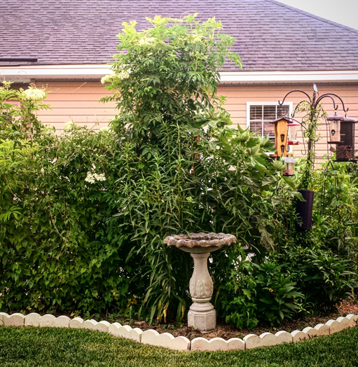
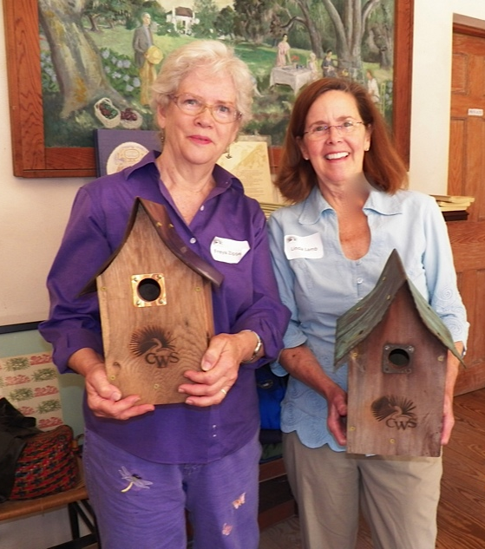
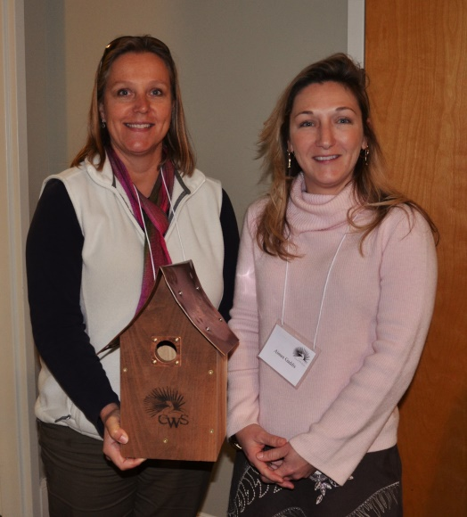
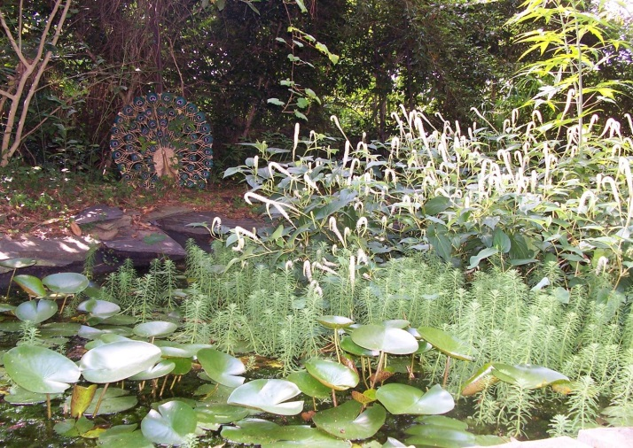
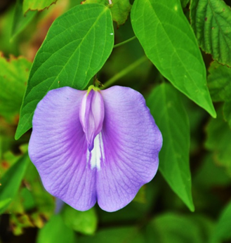
Coastal Habitat Certification

Slide 3
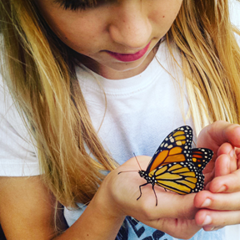
Coastal Habitat Certification
Transform your landscape into a diverse, healthy & beautiful coastal habitat
Guide your understanding of the natural communities of the coast
Guide you in your ability to maintain & enhance native plants in your own landscape
You can have a positive impact
in supporting the significant
biodiversity of the coast!
You will make a difference!

Slide 4
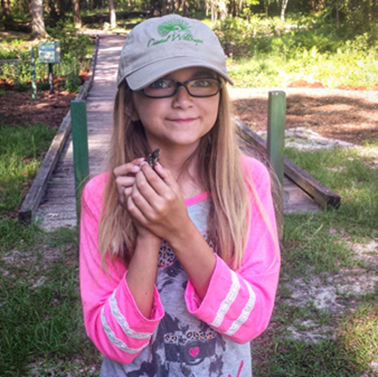
Coastal Habitat
Certification Goal
Goal: to facilitate your participation to protect natural communities, restore habitat structure, & sustainably maintain your garden and landscape
Provide educational experiences & information tailored to coastal species and natural communities
Join us to support biodiversity & the natural beauty of the coast!

Slide 5
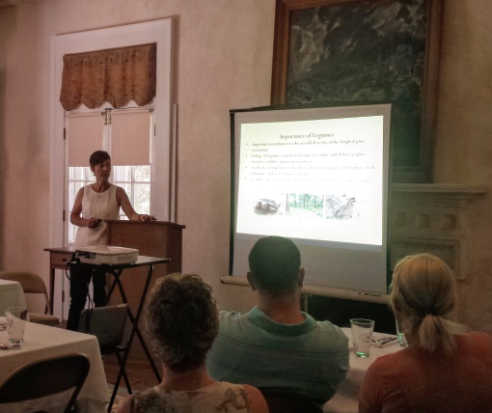
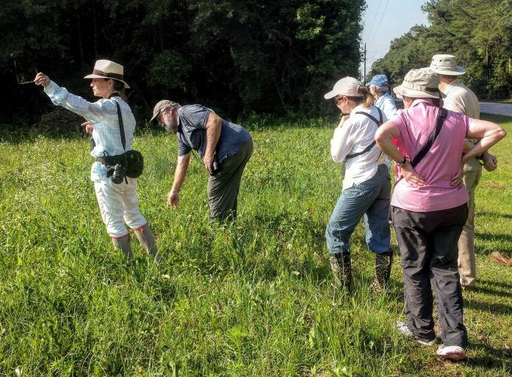
Coastal Habitat Certification Lunch & Learns & Field Trips
Identify your vision for your garden habitat
Understand the function & importance or gardening for biodiversity
Recognize the native species and habitats that might have been on your property
Identify and safely remove invasive plant species
Provide host and nectar plants for native pollinators
Support wildlife nesting, shelter, food & water resources

Slide 6
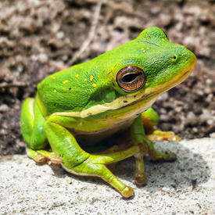
Coastal Habitat Certification Program Schedule
Lunch & learns & field trips are posted on the Coastal WildScapes website
Lunch & learns are open the general public but field trips & certification is only available to CWS members
To join Coastal WildScapes please visit our website at www.coastalwildscapes.org.

Slide 7
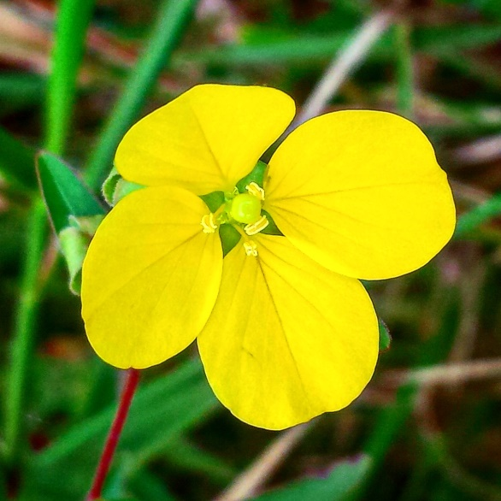
Certification Assessment & Requirements
The certification assessment & requirements process is a working tool to achieve Coastal WildScapes’ Coastal Habitat Certification.
Coastal Habitat Assessment
  Landscape Description
  Native Biodiversity Assessment
  Invasive Species Assessment
Coastal Habitat Requirements
  Provide and Maintain Habitat Structure
  Provide and Maintain Critical Habitat Elements

Slide 8
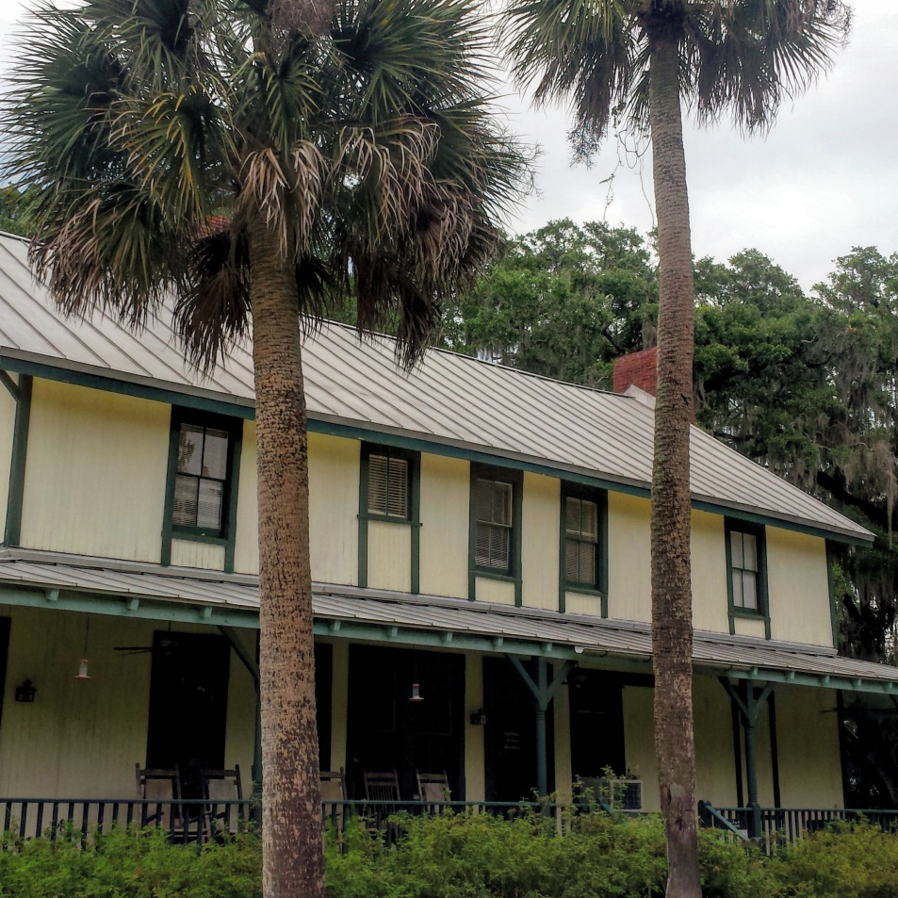
Coastal Habitat Assessment

Slide 9
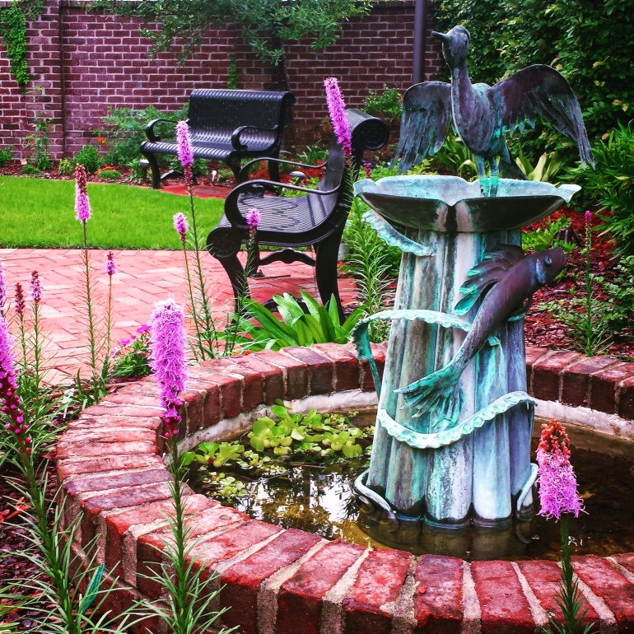
Landscape Description Cont’d

Slide 10
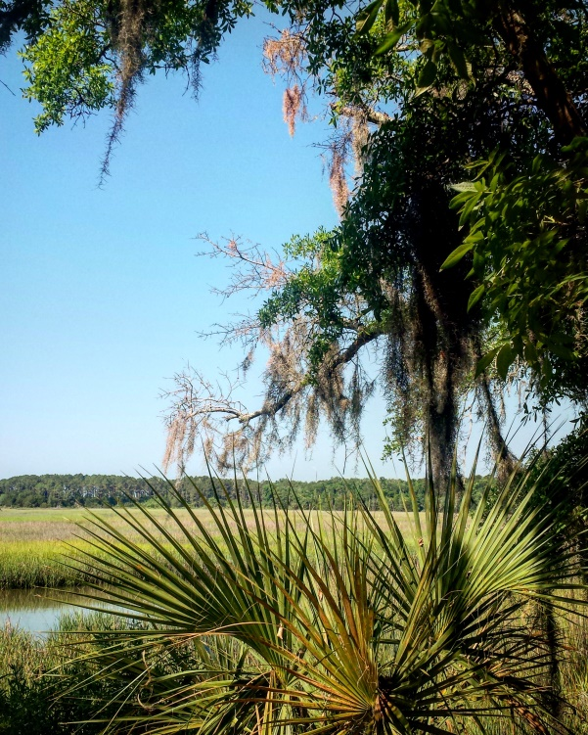
Landscape Description Cont’d

Slide 11
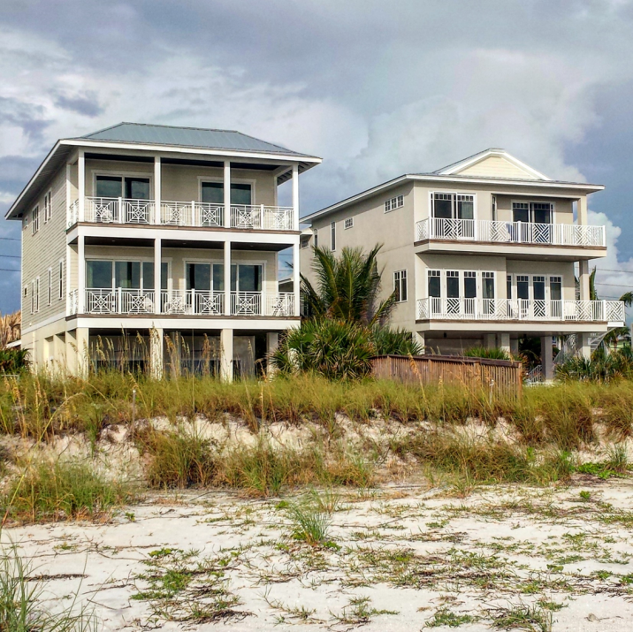
Landscape Description Cont’d

Slide 12
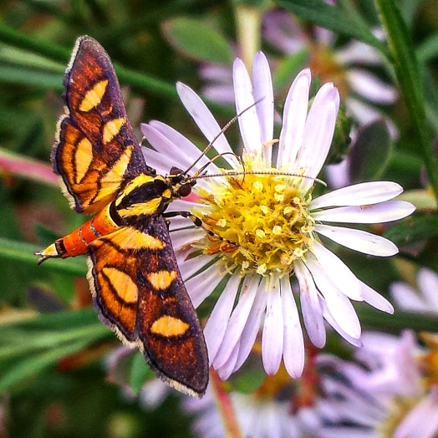
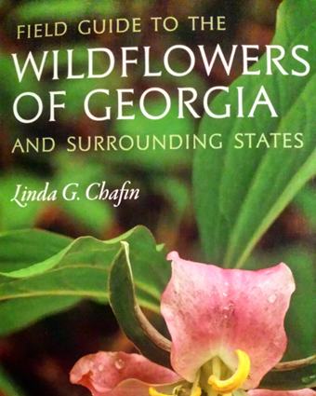
Native Biodiversity
Assessment
NOW OPTIONAL!
List the native plants,
pollinators & animal species on your property
Our web site is a great resource for native plants found in our coastal area
Extensive list of free online ID guides on our website under the Coastal WildScaping tab
Get your “Wildflowers of GA” book & attend our Linda Chafin evening lecture in Savannah (Oct. 4th) or St. Simons Island (Oct. 5th)

Slide 13
Example Biodiversity Assessment

Slide 14
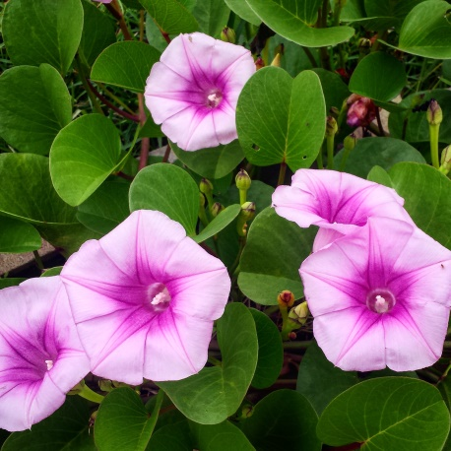
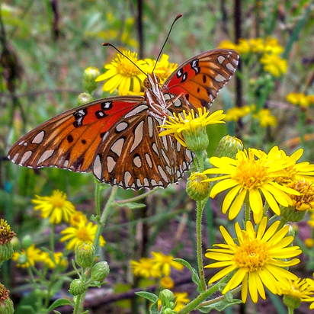
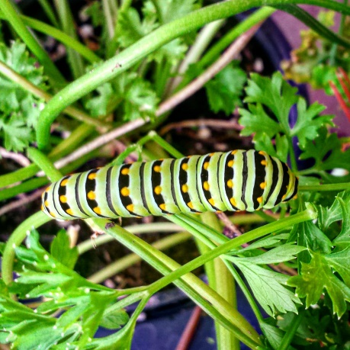
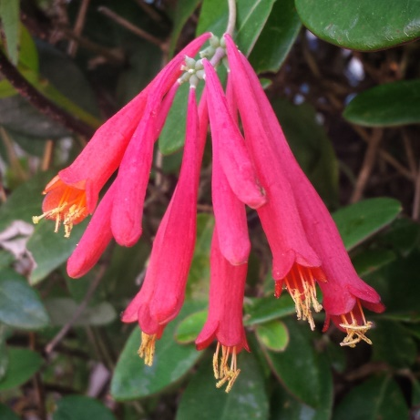
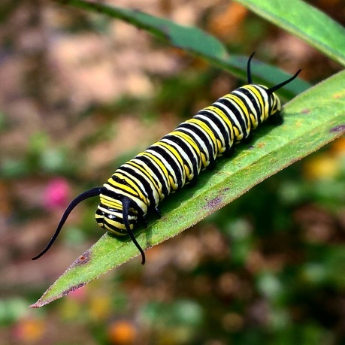
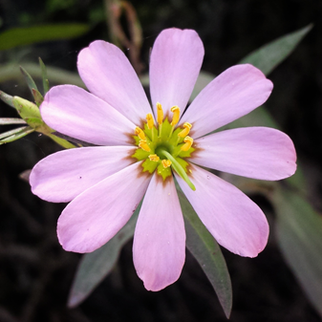
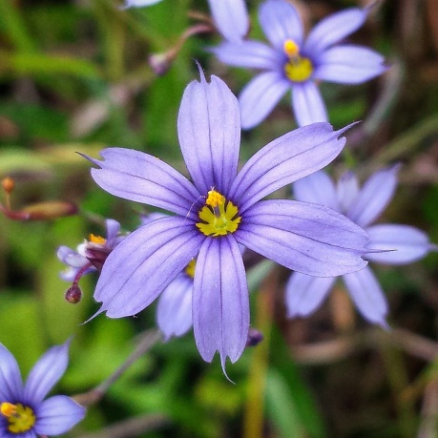
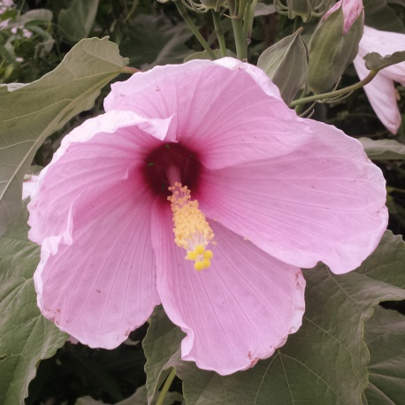
Can you ID These Native Species?

Slide 15
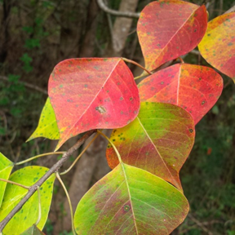
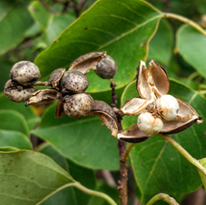
Invasive Species
Assessment
List any exotic invasive plant species of high concern for coastal habitats in your landscapes
Statewide Category 1 Invasive Plant Species
The list is on our web site or go to the GA Exotic Pest Council at www.gaeppc.org
CWS will provide lunch & learns to aid you in invasive exotic species ID & safe removal

Slide 16
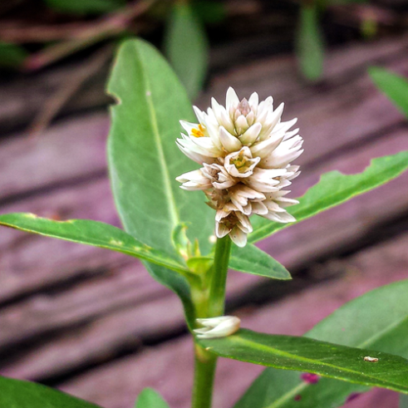
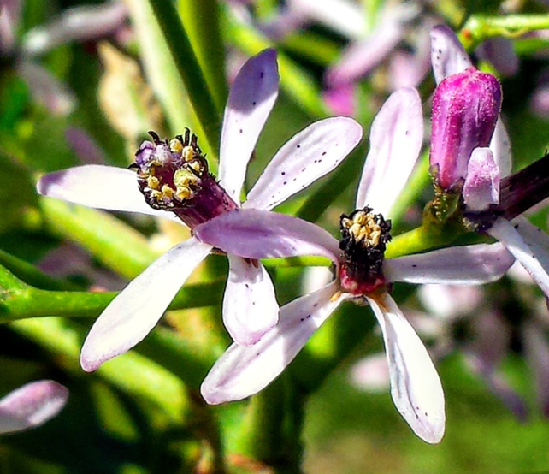
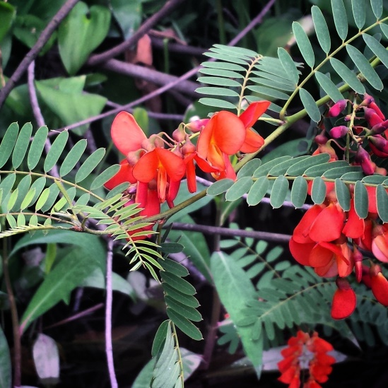
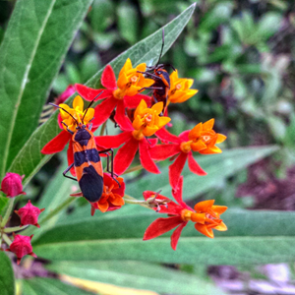
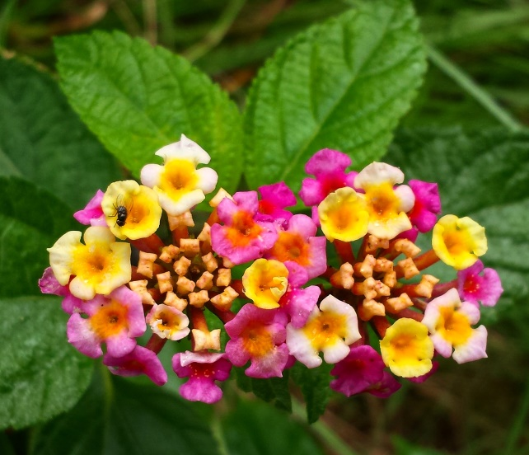
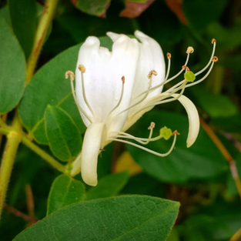
Can you ID these Non-native
&/or Invasive Species?

Slide 17
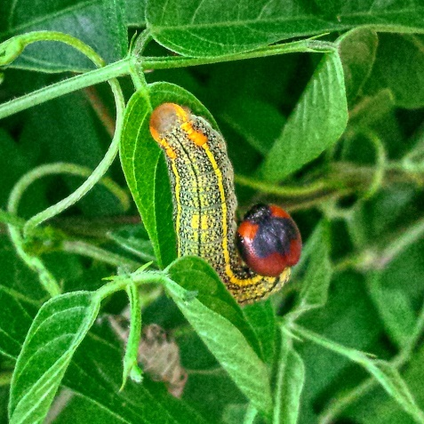
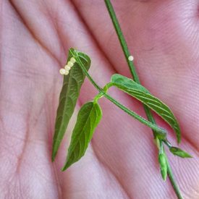
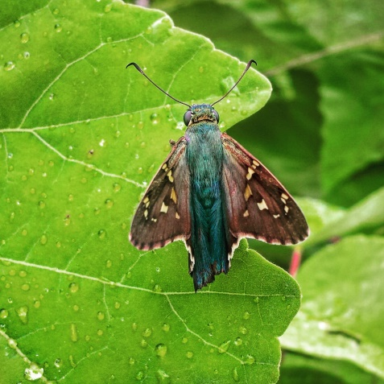
Coastal Habitat Requirements
(Minimum of two in each section)

Slide 18
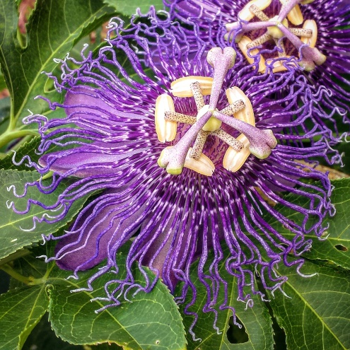
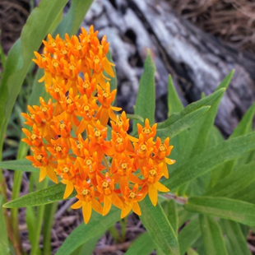
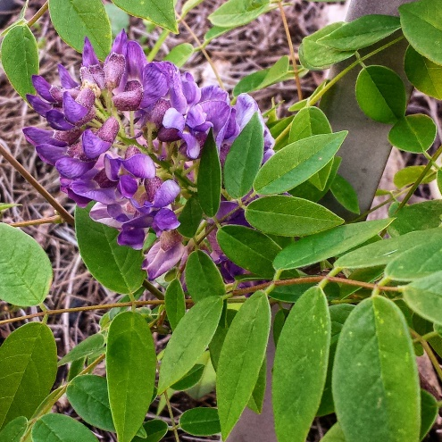
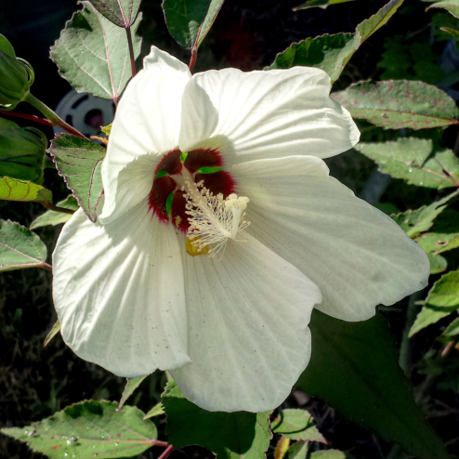
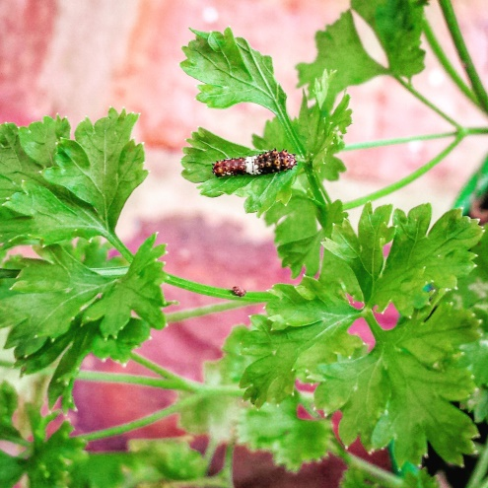
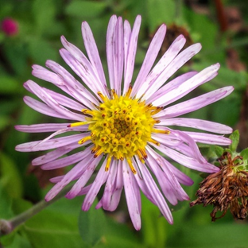
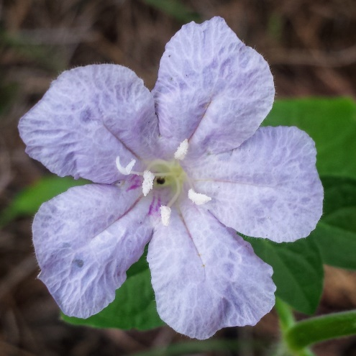
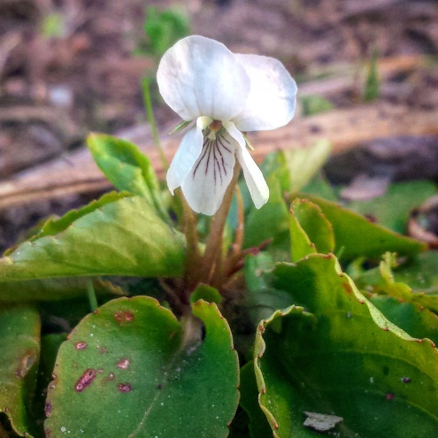
Host Plants for Butterflies

Slide 19
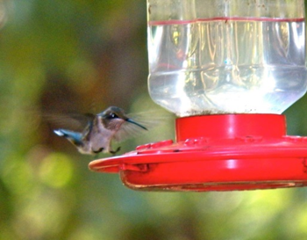
Supplemental Feeders

Slide 20
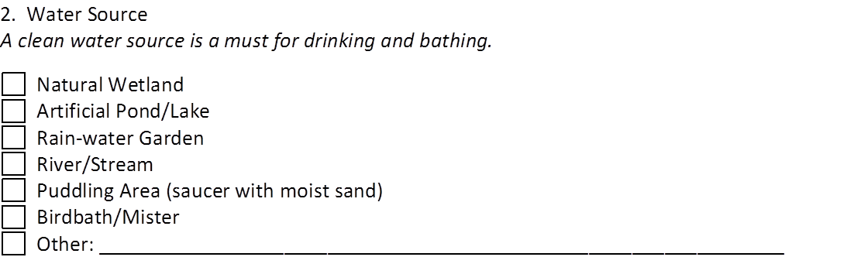
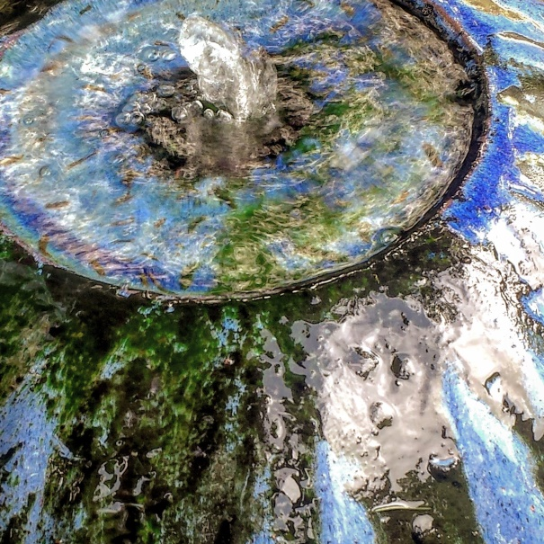
Water Source

Slide 21
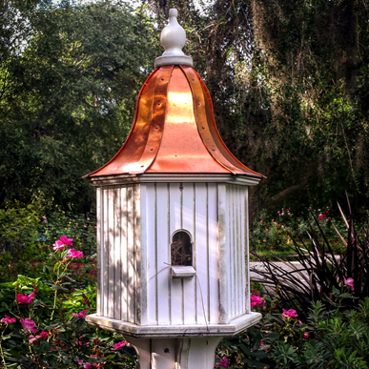
Natural & Artificial Nesting Sites

Slide 22
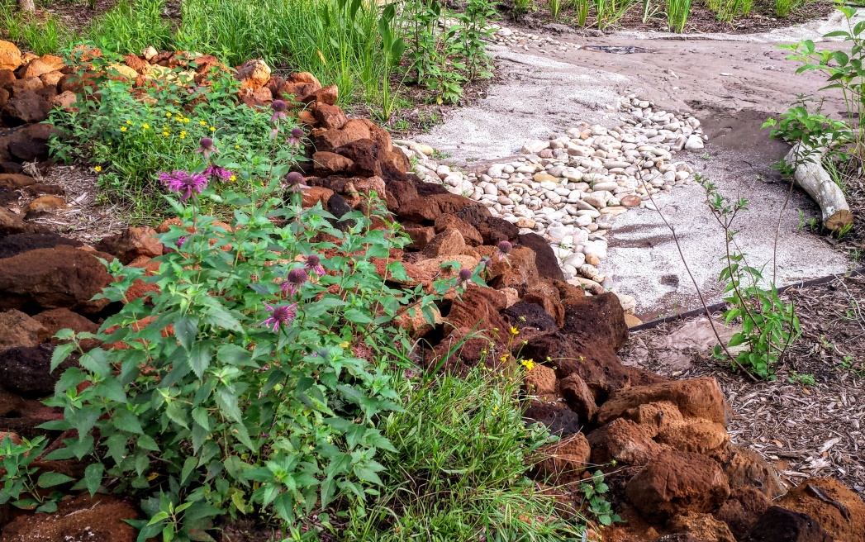
Natural Cover Areas

Slide 23

Sustainable Gardening Practices

Slide 24

Sustainable Gardening Practices (Cont’d)

Slide 25

Exotic Invasive Plant Control

Slide 26

Exotic Animal Species Control

Slide 27

Next Steps
Use this form as a guide to assess your readiness to apply
Sign up for CWS programs to assist in the certification process
Complete the assessment & certification forms:
  Include 3-6 photographs of the garden or landscape to be certified
  $25 certification fee
  Developments / for profit businesses will have a sliding scale fee
Mail or email your completed forms, photographs & certification fee
It will be reviewed by the Coastal WildScapes committee
Once certified, you will receive a personalized certificate & a signature Coastal WildScapes birdhouse

Slide 28













Any Questions?

